Slide 1

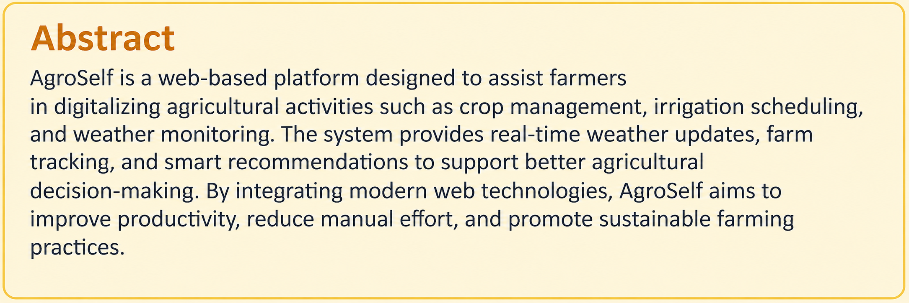
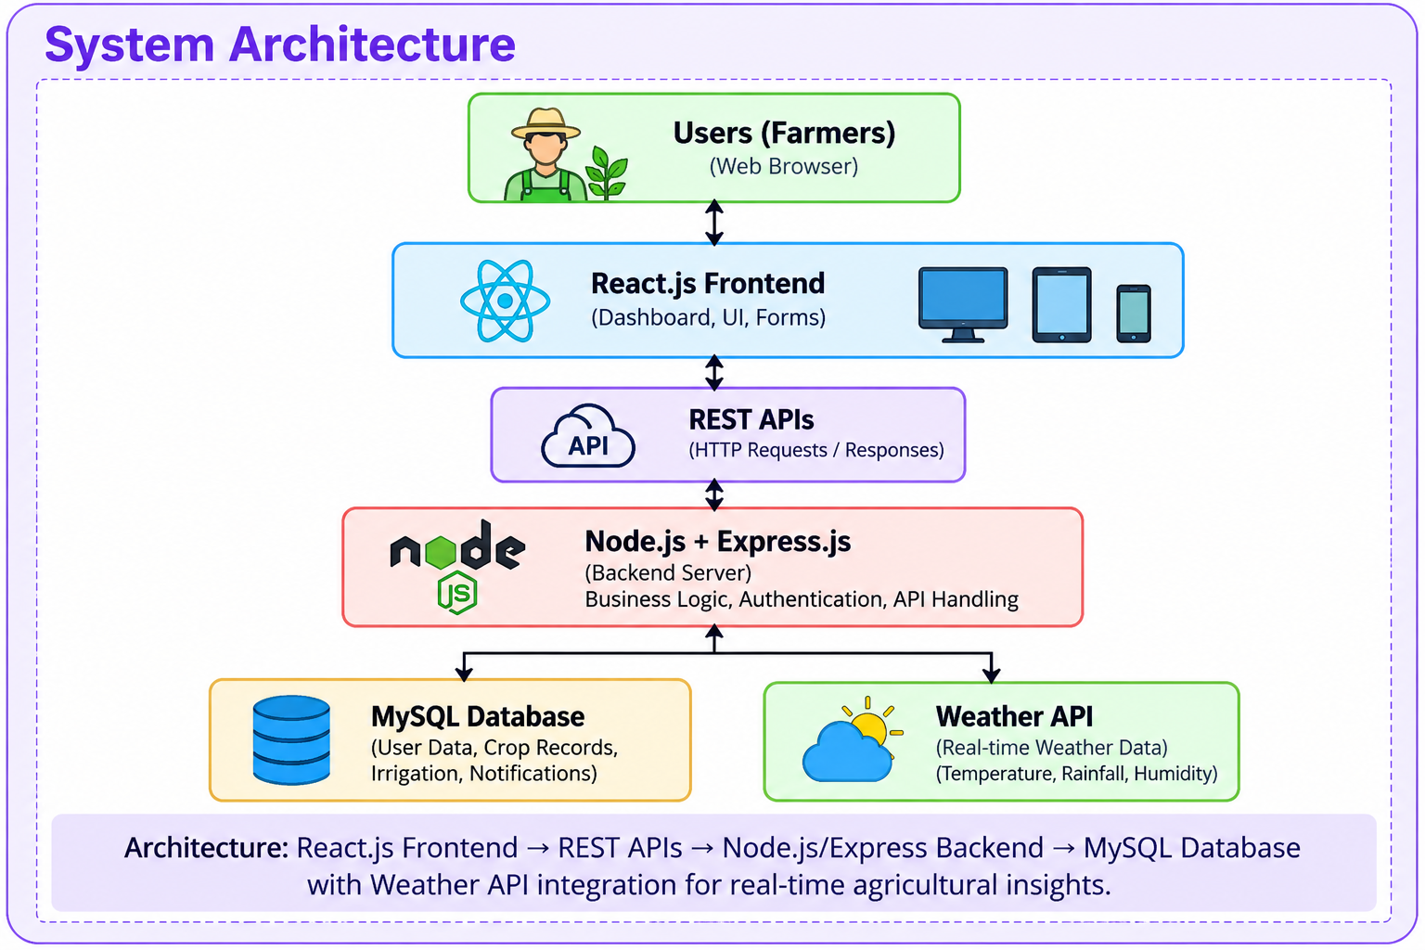
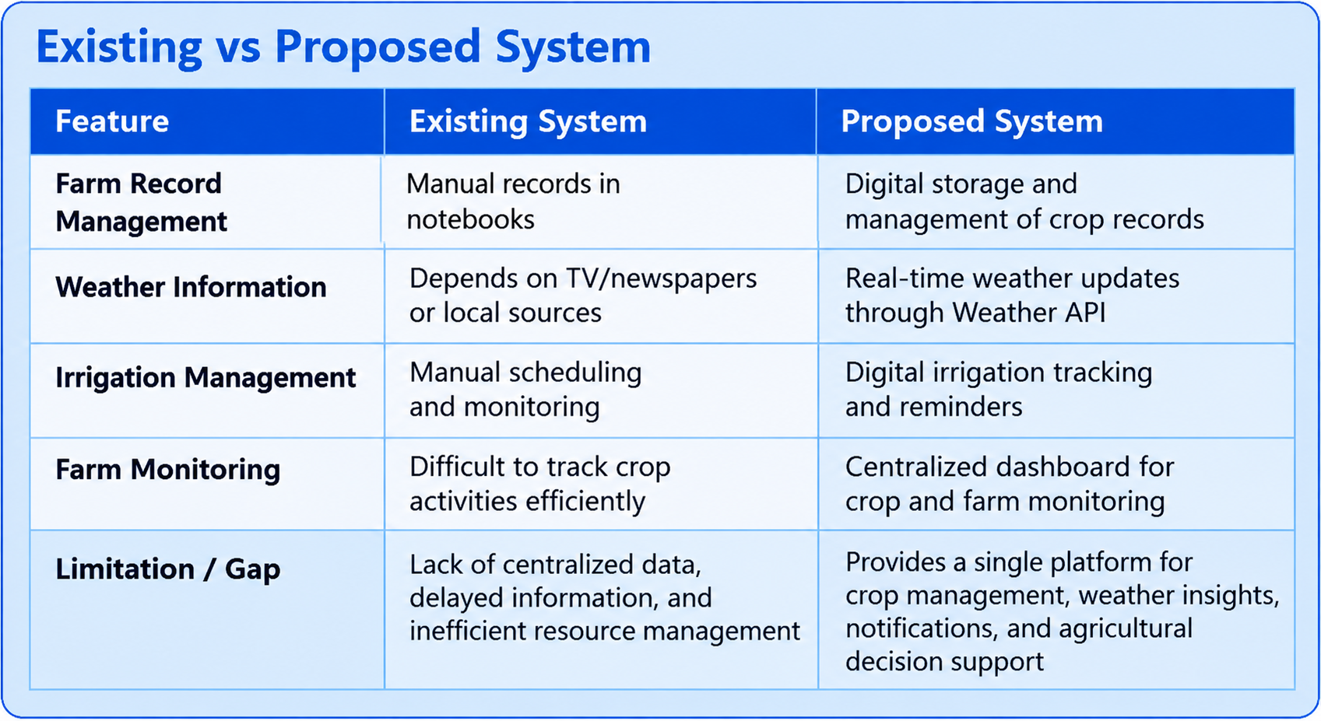
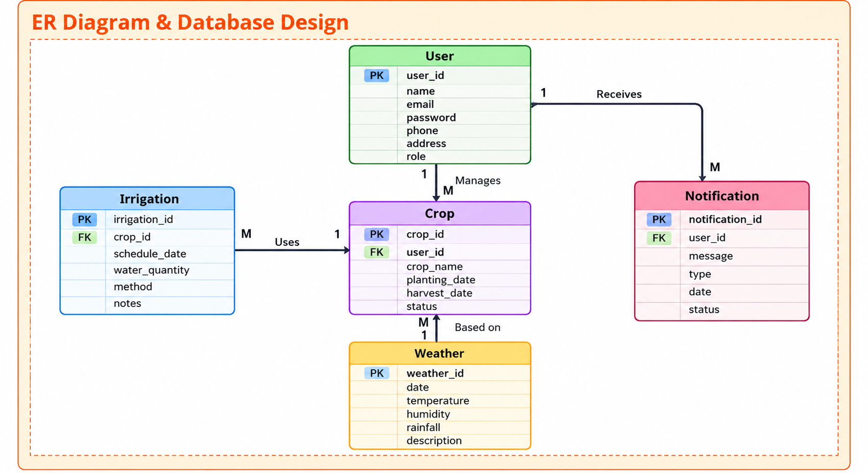
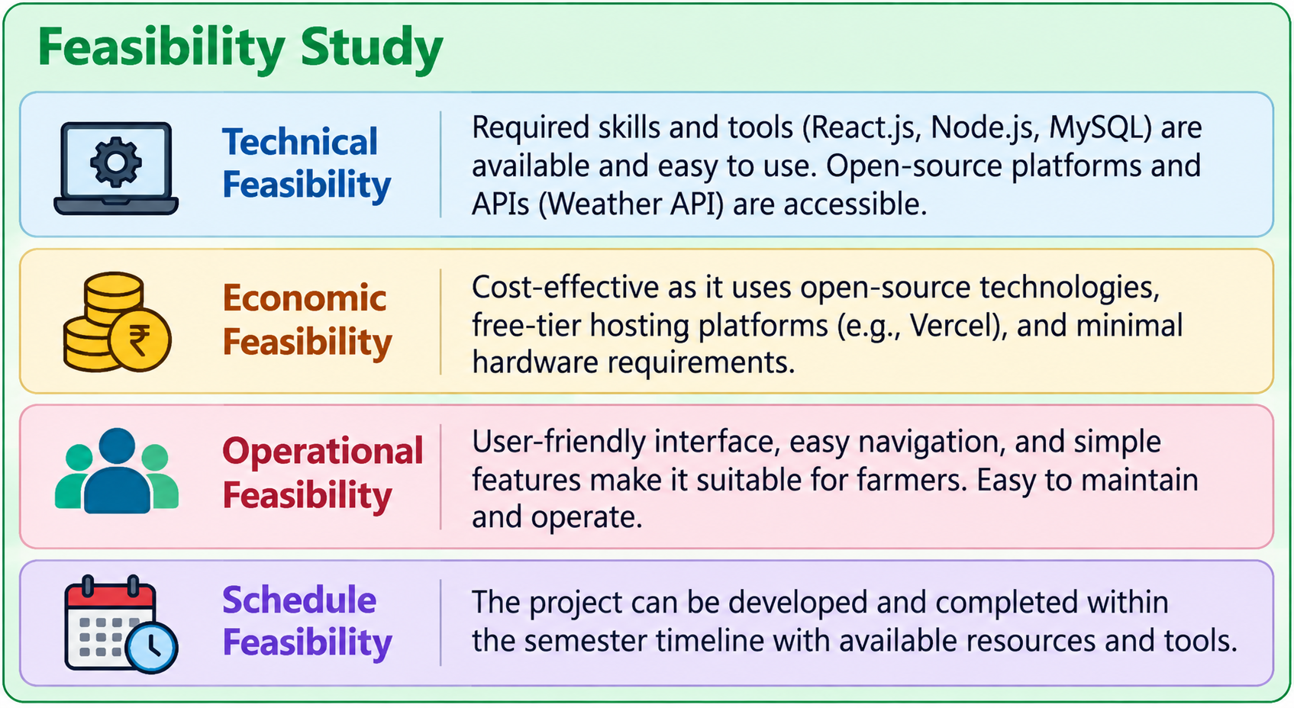
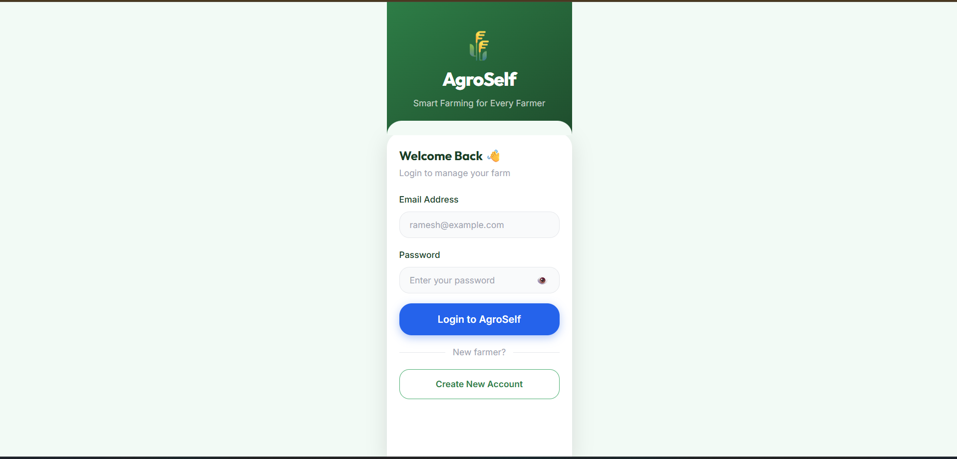
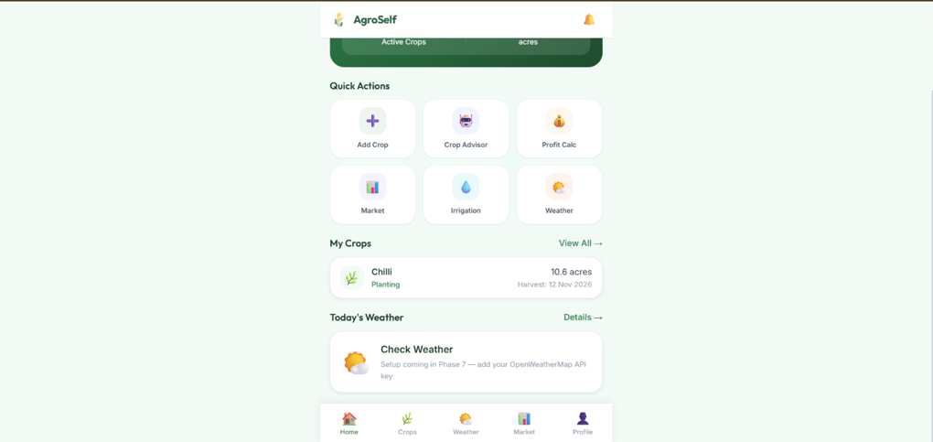
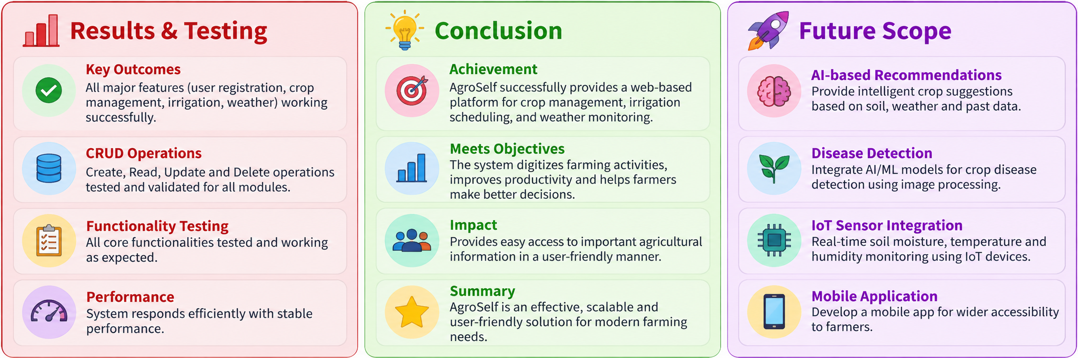

AgroSelf – Agriculture & AgriTech Farmer Self-Service App
Team ID: [11] | Section: [S - 1 | Members: [V.G Shanmukhasai – 2520030341.], [M.Vignesh – 2520030065], [M.Krishna Vamshi Yadav – 2520030344.] | Guide: [Dr. M. Purushotham]
Database Systems Engineering and Distributed Backend Development (25CS1302E) | KLH Bachupally Campus, CSE | PBL 2026-27
Abstract
Tools & Technologies
AgroSelf is a web-based Agriculture and AgriTech Farmer Self-Service Application designed to help farmers manage crop records, irrigation schedules, and farming activities digitally. The platform provides weather insights, farm management tools, and real-time information to support better agricultural decision-making. By integrating modern web technologies.
• Front-End: React.js, HTML5, CSS3, JavaScript
• Back-End: Node.js, Express.js, REST APIs
• Database: MySQL
• External Services: Weather API
• Tools: Git, GitHub, Postman, VS Code, Draw.io, Vercel
• Version Control: Git & GitHub
• Deployment Platform: Vercel Cloud Hosting
Problem Statement & Objectives
Problem: Farmers often rely on manual record-keeping and traditional farming methods, resulting in poor crop monitoring, inefficient irrigation management, and limited access to real-time agricultural information.
• Objective 1: Develop a centralized digital platform for managing farming activities.
• Objective 2: Provide crop tracking, irrigation scheduling, and weather monitoring features.
• Objective 3: Improve agricultural productivity and decision-making through technology.
System Architecture
[Insert architecture diagram: Front-End – REST API – Database]
Existing vs Proposed System
Feature | Existing System | Proposed System
[Feature 1] | [ ] | [ ]
[Feature 2] | [ ] | [ ]
[Feature 3] | [ ] | [ ]
[Feature 4] | [ ] | [ ]
[Limitation / Gap] | [ ] | [How we solve it]
ER Diagram & Database Design
[Insert ER diagram with entities, keys and relationships]
Feasibility Study
Technical: [Required skills, tools and platform availability]
Economic: [Cost – open-source stack, free-tier hosting]
Operational: [User acceptance, ease of use, maintenance]
Schedule: [Completion within the semester timeline]
Implementation Screenshots
[Screenshot 1]
[Screenshot 2]
Results & Testing
Conclusion
Future Scope
[Key outcomes / test results]
[CRUD, validation, performance]
[What was achieved]
[How it meets the objectives]
[Enhancement 1]
[Enhancement 2]
QR: GitHub
References:1 React.js Documentation – https://react.dev
2 Node.js Documentation – https://nodejs.org
[3] Express.js Documentation – https://expressjs.com
[4] MySQL Documentation – https://dev.mysql.com/doc

